Slide 1
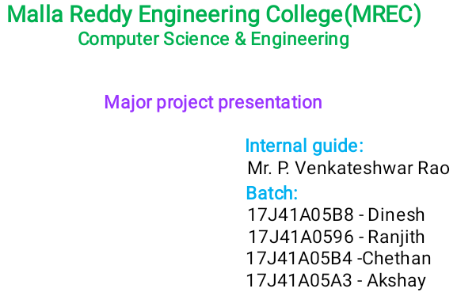
Predictive analytics of Student academic performance in STEM Education

Slide 2
Index
Introduction
Code implementation
Future scope
Conclusion
References

Slide 3
Introduction
Contents of introduction
Introduction
Abstract
Literature review
Existing system
Proposed system
Block diagram
System requirements

Slide 4
Introduction
Quality education is one of the Sustainable Development Goals (SDGs) and is a fundamental challenge to support sustainable development worldwide.
Higher education institutions works on the development of educational models that emphasize the use of information and communication technologies (ICT), which couldfunction as support tools for equal opportunities and social responsibility.
Based on these principles, the main objective of this work was to predict the grades of the students according to several characteristics of their academic performance.

Slide 5
Abstract
Machine Learning (ML) is expected, in the near future, to provide various venues and effective tools to improve education in general, and Science-Technology-Engineering- Mathematics (STEM) education in particular. The Gartner Analytics Ascendancy Model requires the use of four types of data analytics to be considered comprehensive: descriptive, diagnostic, predictive and prescriptive data analytics.
It aimed at the setup and benchmarking of eight ML algorithms for predictive learning analytics, specifically, a prediction of student academic performance in a course.
The results obtained by the experiments allow us to reach conclusions about the creation of action plans to avoid drop-out in the classrooms and to personalize the student follow-up as much as possible, as well as to make valuable information available to the student that allows them to evaluate their academic performance so that they take improvement actions in the subjects that have the highest risk of failing.

Slide 6
Literature review
A survey of data mining techniques for traditional educational systems such as adaptive web-based and content management systems is presented in .
An association rule based mining method is applied for selection of weak students in a school and is found effective . Genetic Algorithm is used to assign the weights for the modeling of students’ grade for three levels (binary, 3-level and 9-level) . It shows that the combination of multiple classifiers leads to a significant improvement in classification.
A model is proposed for predicting student performance using six machine learning techniques for distance learning education, which is quite different from the traditional educational system .

Slide 7
A prediction model is presented to forecast the Student Academic Performance (SAP) of undergraduate engineering students. An investigation of student performance is made through a longitudinal study.
A novel approach predicts the number of times a student repeats a course. It uses neural networks to find relationship between some attributes of students for course assessment.
The prediction of grade and prediction of approval/failure problems of students is addressed by. The employability of master level students is predicted by and draws the conclusion that empathy, drive and stress management abilities are major emotional parameters for employability.

Slide 8
Existing system
Predicting student’s performance becomes more challenging due to the large volume of data in educational databases. Currently the lack of an existing system to analyze and monitor the student progress and performance is not being addressed.
There are two main reasons why this is happening. First, the study of existing prediction methods is still insufficient to identify the most suitable methods for predicting the performance of students, second is due to the lack of investigations on the factors affecting student’s achievements in particular courses within context.
Therefore a systematic literature review on predicting student performance by using ML techniques is proposed to improve student’s achievements.

Slide 9
Proposed system
The objective is to provide an overview on the machine learning techniques that have been used to predict student’s performance.it also focuses on how the prediction algorithm can be used to identify the most important attributes in a student’s data.
We could actually improve student’s achievement and success more effectively in an efficient way using educational ML techniques it could bring the benefits and impacts to students, educators and academic institutions.

Slide 10
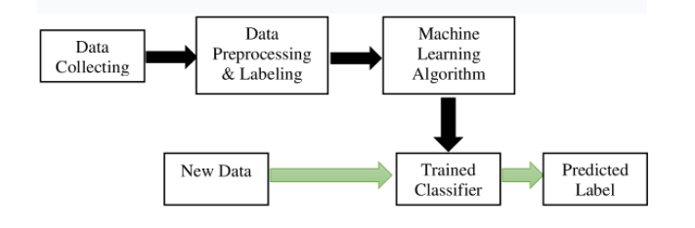
Block diagram

Slide 11
System requirements
Hardware Requirements
System : Intel i3 2.4 GHz.
Hard Disk : 100 GB above.
Monitor : 14 Colour Monitor or any size.
Mouse : Optical Mouse.
Ram : 2 GB.
Software Requirements
Operating system : Windows 10 (any windows operating system).
Coding Language : Python.
Front-End : Python
Designing : tkinter module.
Data Base : sqlite3, Mysqlclient.
IDE : Anaconda IDE – Jupyter Note Book

Slide 12
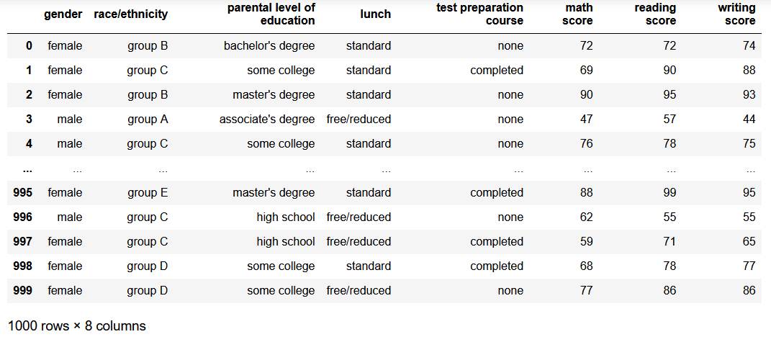
Code implementation
data

Slide 13
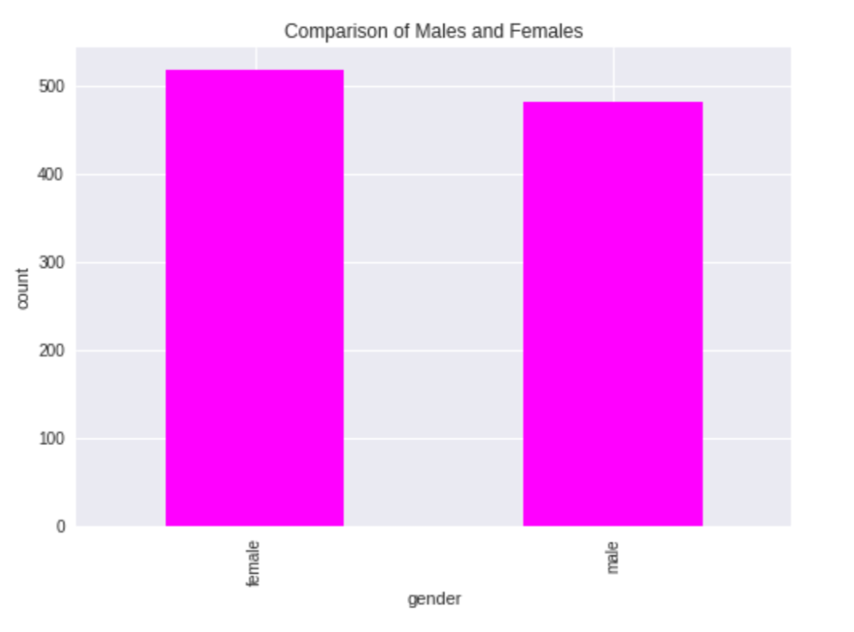
# visualising the number of male and female in the dataset
data['gender'].value_counts(normalize = True)
data['gender'].value_counts(dropna = False).plot.bar(color = 'magenta')

Slide 14
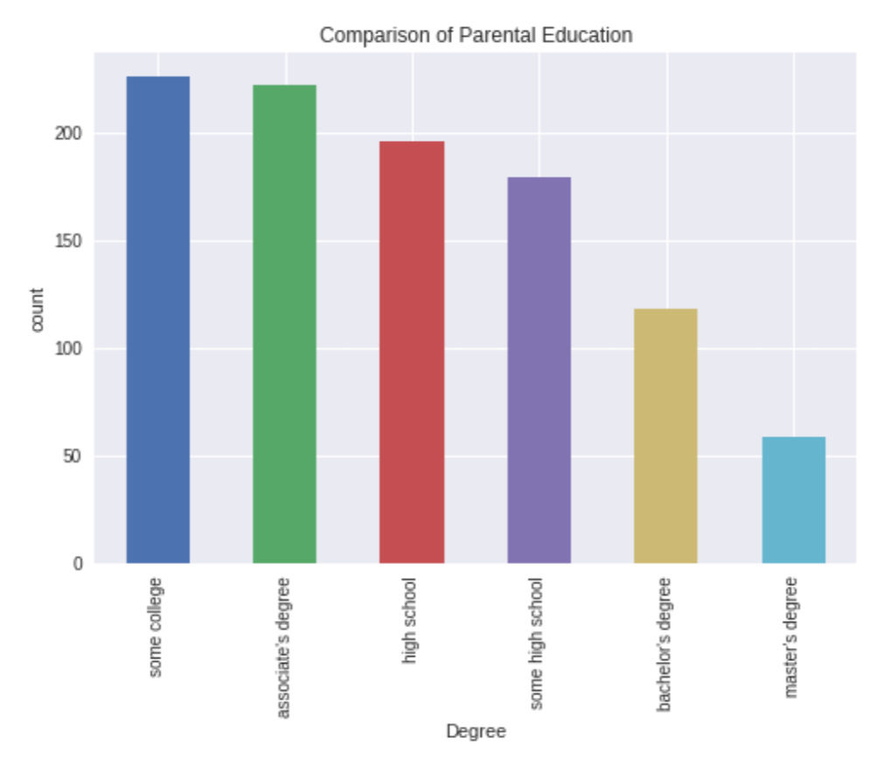
# visualizing the differnt parental education levels
data['parental level of education'].value_counts(normalize = True)
data['parental level of education'].value_counts(dropna = False).plot.bar()

Slide 15
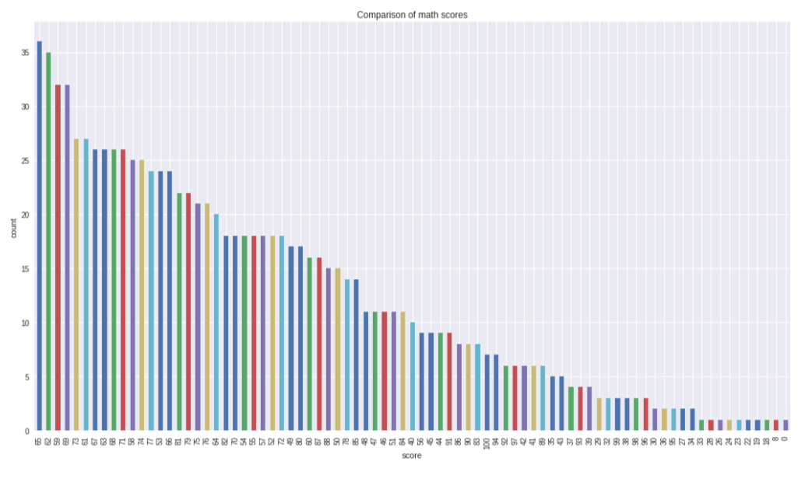
# visualizing maths score
data['math score'].value_counts(normalize = True)
data['math score'].value_counts(dropna = False).plot.bar(figsize = (18, 10))

Slide 16
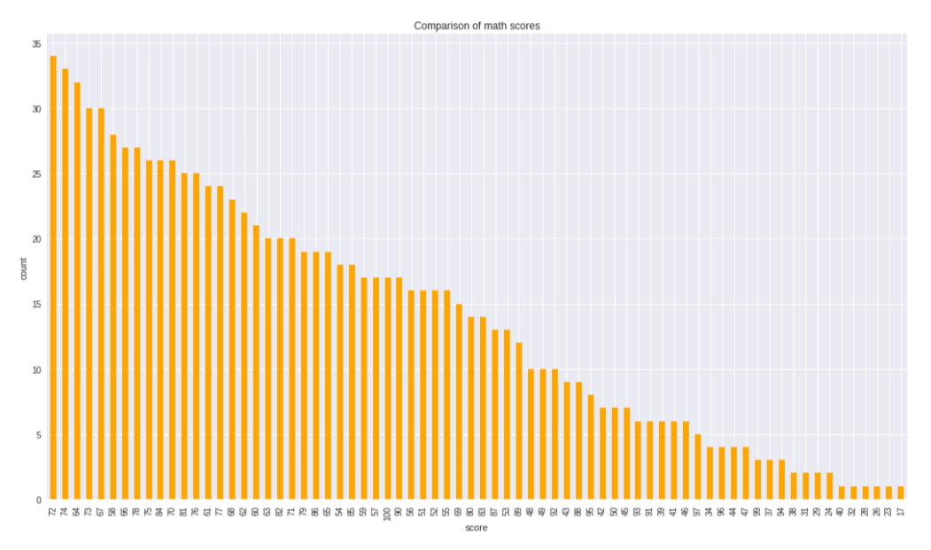
# visualizing reading score score
data['reading score'].value_counts(normalize = True)
data['reading score'].value_counts(dropna = False).plot.bar(figsize = (18, 10), color = 'orange')

Slide 17
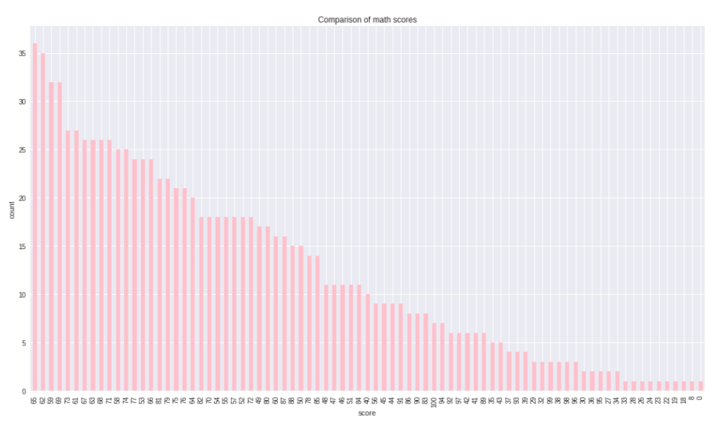
# visualizing writing score
data['math score'].value_counts(normalize = True)
data['math score'].value_counts(dropna = False).plot.bar(figsize = (18, 10), color = 'pink')

Slide 18
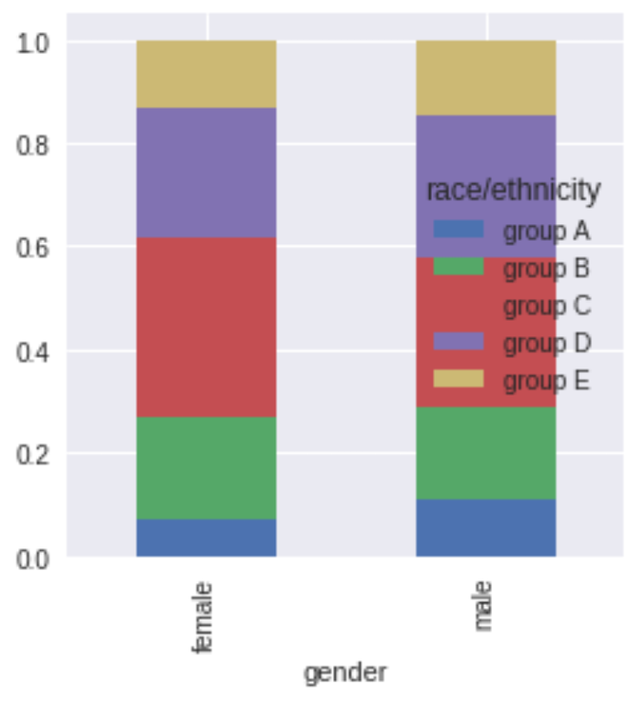
# gender vs race/ethnicity
x = pd.crosstab(data['gender'], data['race/ethnicity'])
x.div(x.sum(1).astype(float), axis = 0).plot(kind = 'bar', stacked = True, figsize = (4, 4))

Slide 19
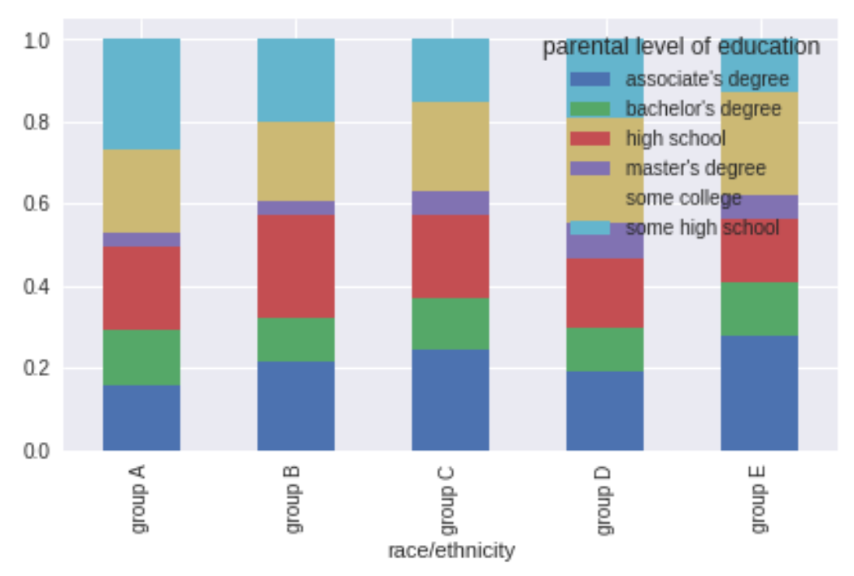
#comparison of race/ethnicity and parental level of education
x = pd.crosstab(data['race/ethnicity'], data['parental level of education'])
x.div(x.sum(1).astype(float), axis = 0).plot(kind = 'bar', stacked = 'True', figsize = (7, 4) )

Slide 20
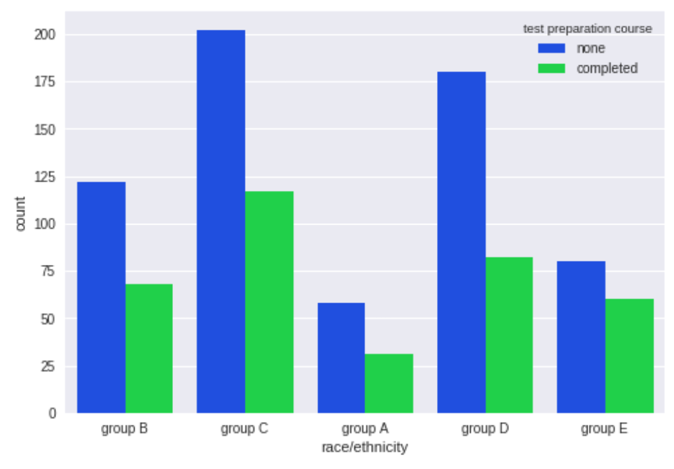
# comparison of race/ethnicity and test preparation course
sns.countplot(x = 'race/ethnicity', data = data, hue = 'test preparation course', palette = 'bright')

Slide 21
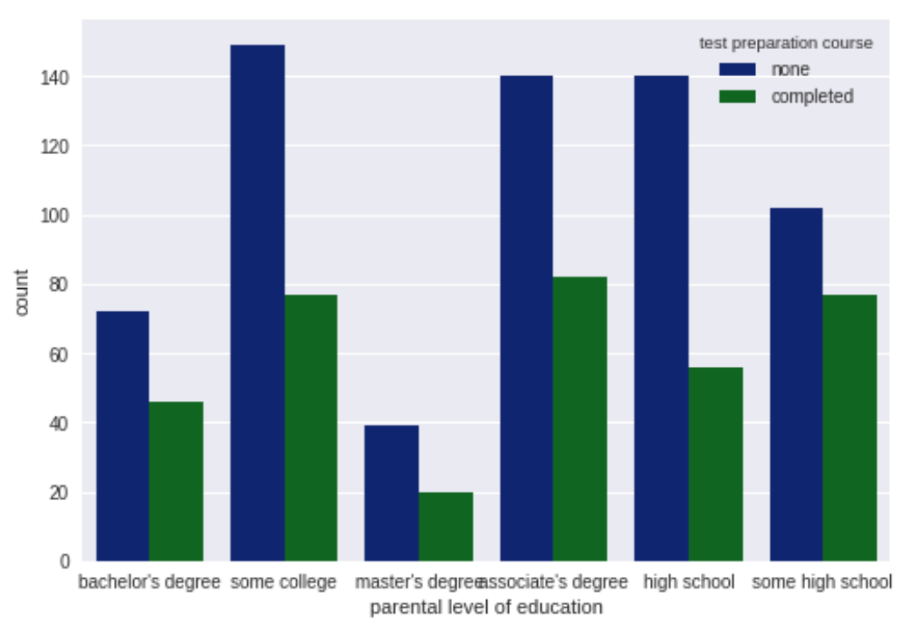
# comparison of parental degree and test course
sns.countplot(x = 'parental level of education', data = data, hue = 'test preparation course', palette = 'dark')

Slide 22
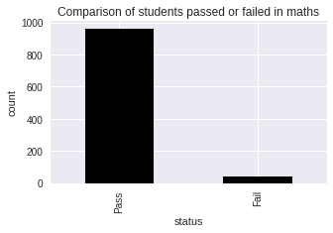
# feature engineering on the data to visualize and solve the dataset more accurately
# setting a passing mark for the students to pass on the three subjects individually
passmarks = 40
# creating a new column pass_math, this column will tell us whether the students are pass or fail in math_ score
data['pass_math'] = np.where(data['math score']< passmarks, 'Fail', 'Pass')
data['pass_math'].value_counts(dropna = False).plot.bar(color = 'black', figsize = (5, 3))

Slide 23
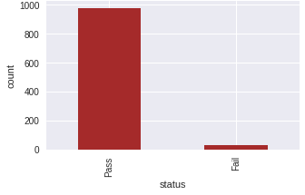
# creating a new column pass_reading, this column will tell us whether the students are pass or fail in reading score
data['pass_reading'] = np.where(data['reading score']< passmarks, 'Fail', 'Pass')
data['pass_reading'].value_counts(dropna = False).plot.bar(color = 'brown', figsize = (5, 3))

Slide 24
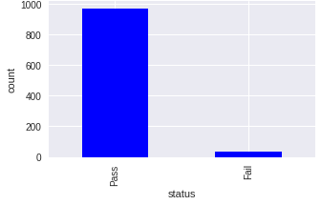
# creating a new column pass_writing, this column will tell us whether the students are pass or fail in writing score
data['pass_writing'] = np.where(data['writing score']< passmarks, 'Fail', 'Pass')
data['pass_writing'].value_counts(dropna = False).plot.bar(color = 'blue', figsize = (5, 3))

Slide 25
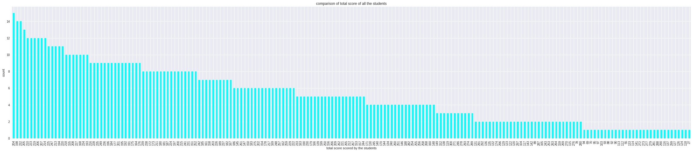
#computing the total score for each student by
data['total_score'] = data['math score'] + data['reading score'] + data['writing score']
#comparison of total score of all the students
data['total_score'].value_counts(normalize = True)
data['total_score'].value_counts(dropna = True).plot.bar(color = 'cyan', figsize = (40, 8))

Slide 26
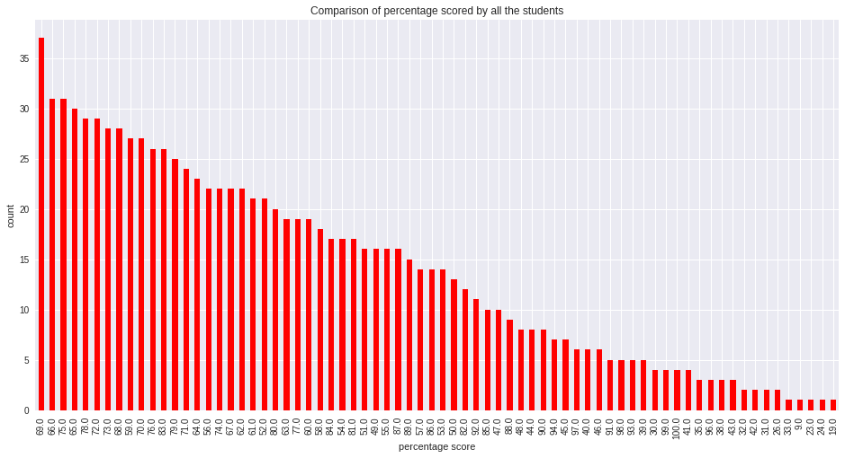
#computing percentage for each of the students
# importing math library to use ceil
from math import *
data['percentage'] = data['total_score']/3
for i in range(0, 1000):
data['percentage'][i] = ceil(data['percentage'][i])
#comparison of percentage scored by all the students
data['percentage'].value_counts(normalize = True)
data['percentage'].value_counts(dropna = False).plot.bar(figsize = (16, 8), color = 'red')

Slide 27
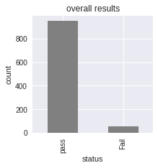
#checking which student is fail overall
data['status'] = data.apply(lambda x : 'Fail' if x['pass_math'] == 'Fail' or
x['pass_reading'] == 'Fail' or x['pass_writing'] == 'Fail'
else 'pass', axis = 1)
#overall results
data['status'].value_counts(dropna = False).plot.bar(color = 'gray', figsize = (3, 3))

Slide 28
'''Assigning the grades to the grades according to the following criteria :
0 - 40 marks : grade E
41 - 60 marks : grade D
60 - 70 marks : grade C
70 - 80 marks : grade B
80 - 90 marks : grade A
90 - 100 marks : grade O '''
def getgrade(percentage, status):
if status == 'Fail':
return 'E'
if(percentage >= 90):
return 'O'
if(percentage >= 80):
return 'A'
if(percentage >= 70):
return 'B'
if(percentage >= 60):
return 'C'
if(percentage >= 40):
return 'D'
else :
return 'E'
data['grades'] = data.apply(lambda x: getgrade(x['percentage'], x['status']), axis = 1 )

Slide 29
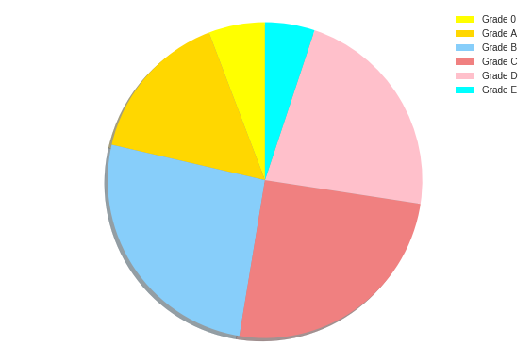
#Plotting a pie chart for the distribution of various grades amongst the students
labels = ['Grade 0', 'Grade A', 'Grade B', 'Grade C', 'Grade D', 'Grade E']
sizes = [58, 156, 260, 252, 223, 51]
colors = ['yellow', 'gold', 'lightskyblue', 'lightcoral', 'pink', 'cyan']
explode = (0.0001, 0.0001, 0.0001, 0.0001, 0.0001, 0.0001)
patches, texts = plt.pie(sizes, colors=colors, shadow=True, startangle=90)

Slide 30
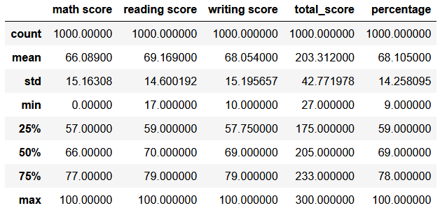
data.describe()

Slide 31
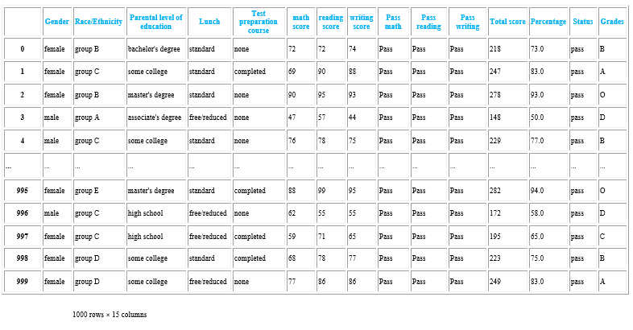
data

Slide 32
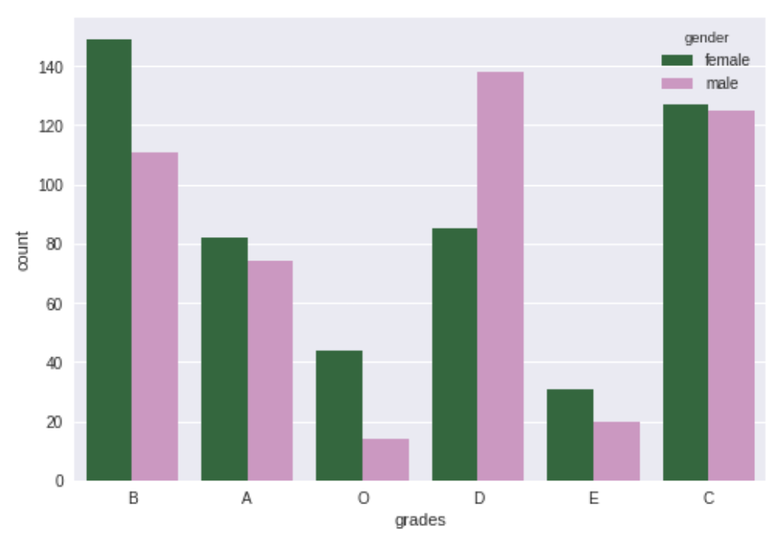
# comparing the distribution of grades among males and females
sns.countplot(x = data['grades'], data = data, hue = data['gender'], palette = 'cubehelix')
#sns.palplot(sns.dark_palette('purple'))

Slide 33
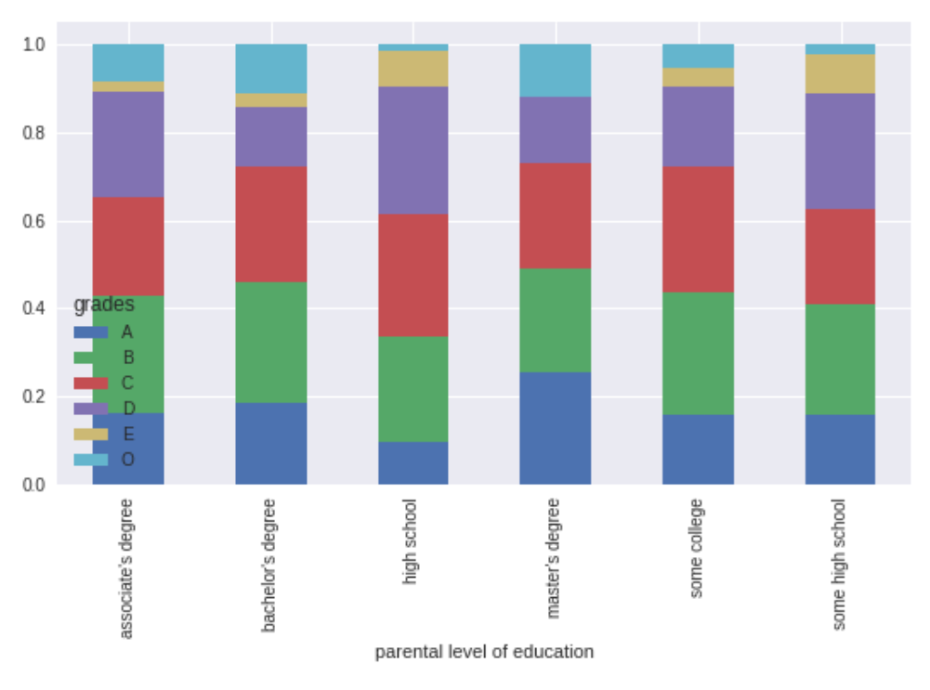
# comparison parent's degree and their corresponding grades
x = pd.crosstab(data['parental level of education'], data['grades'])
x.div(x.sum(1).astype(float), axis = 0).plot(kind = 'bar', stacked = True, figsize = (9, 5))

Slide 34
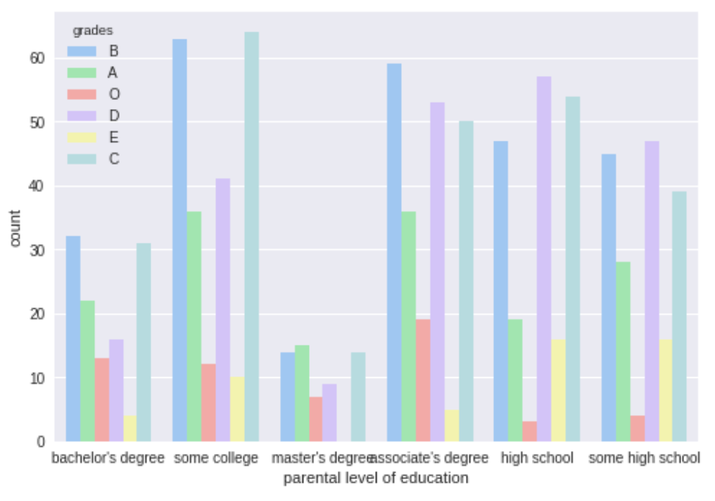
# comparison parent's degree and their corresponding grades
# plotting it using seaborn
sns.countplot(x = data['parental level of education'], data = data, hue = data['grades'], palette = 'pastel')

Slide 35
#label encoding non numeric valued attributes
from sklearn.preprocessing import LabelEncoder
# creating an encoder
le = LabelEncoder()
# label encoding for test preparation course
data['test preparation course'] = le.fit_transform(data['test preparation course'])
data['test preparation course'].value_counts()
Output:
1 642
0 358
Name: test preparation course, dtype: int64
# label encoding for lunch
data['lunch'] = le.fit_transform(data['lunch'])
data['lunch'].value_counts()
Output:
1 645
0 355
Name: lunch, dtype: int64

Slide 36
# label encoding- race/ethnicity
# we have to map values to each of the categories
data['race/ethnicity'] = data['race/ethnicity'].replace('group A', 1)
data['race/ethnicity'] = data['race/ethnicity'].replace('group B', 2)
data['race/ethnicity'] = data['race/ethnicity'].replace('group C', 3)
data['race/ethnicity'] = data['race/ethnicity'].replace('group D', 4)
data['race/ethnicity'] = data['race/ethnicity'].replace('group E', 5)
data['race/ethnicity'].value_counts()
Output:
3 319
4 262
2 190
5 140
1 89
Name: race/ethnicity, dtype: int64

Slide 37
# label encoding for parental level of education
data['parental level of education'] = le.fit_transform(data['parental level of education'])
data['parental level of education'].value_counts()
Output:
4 226
0 222
2 196
5 179
1 118
3 59
Name: parental level of education, dtype: int64
# label encoding for gender
data['gender'] = le.fit_transform(data['gender'])
data['gender'].value_counts()
Output:
0 518
1 482
Name: gender, dtype: int64

Slide 38
# label encoding for pass_math
data['pass_math'] = le.fit_transform(data['pass_math'])
data['pass_math'].value_counts()
1 960
0 40
Name: pass_math, dtype: int64
# label encoding for pass_reading
data['pass_reading'] = le.fit_transform(data['pass_reading'])
data['pass_reading'].value_counts()
Output:
1 974
0 26
Name: pass_reading, dtype: int64
# label encoding for pass_writing
data['pass_writing'] = le.fit_transform(data['pass_writing'])
data['pass_writing'].value_counts()
Output:
1 968
0 32
Name: pass_writing, dtype: int64

Slide 39
# label encoding for status
data['status'] = le.fit_transform(data['status'])
data['status'].value_counts()
Output:
1 949
0 51
Name: status, dtype: int64
# label encoding for grades
# we have to map values to each of the categories
data['grades'] = data['grades'].replace('O', 0)
data['grades'] = data['grades'].replace('A', 1)
data['grades'] = data['grades'].replace('B', 2)
data['grades'] = data['grades'].replace('C', 3)
data['grades'] = data['grades'].replace('D', 4)
data['grades'] = data['grades'].replace('E', 5)
data['race/ethnicity'].value_counts()
Output:
3 319
4 262
2 190
5 140
1 89
Name: race/ethnicity, dtype: int64

Slide 40
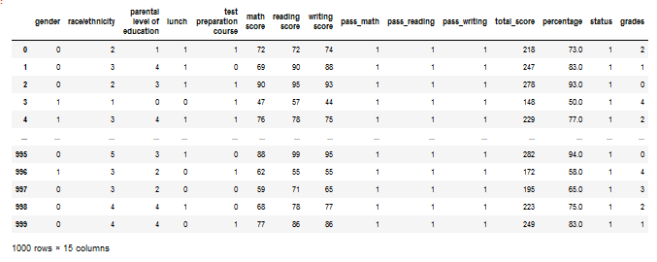
data

Slide 41
#testing the result against several ml techniques
#splitting dependent and independent variables
x = data.iloc[:,:14]
y = data.iloc[:,14]
print(x.shape)
print(y.shape)
Output:
(1000, 14)
(1000,)
#splitting the dataset into training and test sets
from sklearn.model_selection import train_test_split
x_train, x_test, y_train, y_test = train_test_split(x, y, test_size = 0.25, random_state = 45)
print(x_train.shape)
print(y_train.shape)
print(x_test.shape)
print(y_test.shape)
Output:
(750, 14)
(750,)
(250, 14)
(250,)

Slide 42
#importing the MinMaxScaler
from sklearn.preprocessing import MinMaxScaler
#creating a scaler
mm = MinMaxScaler()
#Feeding the independent variable into the scaler
x_train = mm.fit_transform(x_train)
x_test = mm.transform(x_test)

Slide 43
#applying principal components analysis
#creating a principal component analysis model
from sklearn.decomposition import PCA
#pca = PCA(n_components = None)
#feeding the independent variables to the PCA model
#x_train = pca.fit_transform(x_train)
#x_test = pca.transform(x_test)
#visualising the principal components that will explain the highest share of variance
#explained_variance = pca.explained_variance_ratio_
#print(explained_variance)
#creating a principal component analysis model
#pca = PCA(n_components = 2
#feeding the independent variables to the PCA model
#x_train = pca.fit_transform(x_train)
#x_test = pca.transform(x_test)

Slide 44
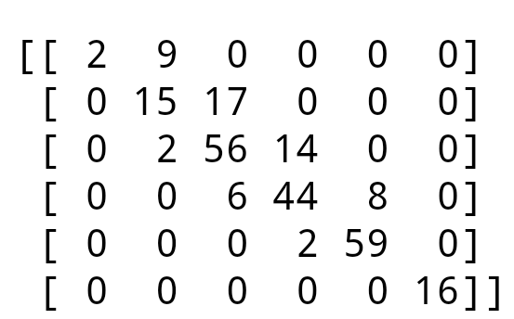
#logistic regression
from sklearn.linear_model import LogisticRegression
# creating a model
model = LogisticRegression()
# feeding the training data to the model
model.fit(x_train, y_train)
# predicting the test set results
y_pred = model.predict(x_test)
# calculating the classification accuracies
print("Training Accuracy :", model.score(x_train, y_train))
print("Testing Accuracy :", model.score(x_test, y_test))
Output:
Training Accuracy : 0.7786666666666666
Testing Accuracy : 0.768
# printing the confusion matrix
from sklearn.metrics import confusion_matrix
# creating a confusion matrix
cm = confusion_matrix(y_test, y_pred)
# printing the confusion matrix
print(cm)

Slide 45
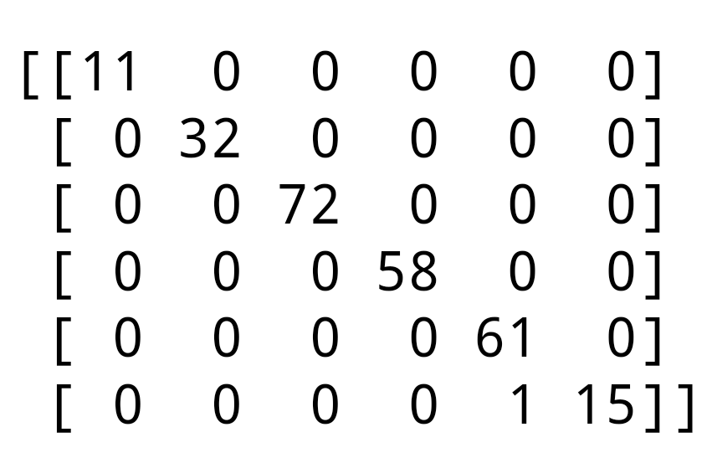
#Random forest
from sklearn.ensemble import RandomForestClassifier
# creating a model
model = RandomForestClassifier()
# feeding the training data to the model
model.fit(x_train, y_train)
# predicting the x-test results
y_pred = model.predict(x_test)
# calculating the accuracies
print("Training Accuracy :", model.score(x_train, y_train))
print("Testing Accuracy :", model.score(x_test, y_test))
# printing the confusion matrix
from sklearn.metrics import confusion_matrix
# creating a confusion matrix
cm = confusion_matrix(y_test, y_pred)
# printing the confusion matrix
print(cm)

Slide 46
# k fold cross validation
from sklearn.model_selection import cross_val_score
# computing accuracies for 20 different model's accuracy
accuracies = cross_val_score(estimator = model, X = x_train, y = y_train, cv = 20)
print(accuracies)
# computing mean of accuaracies obtained by all the models
print("mean accuracy :", accuracies.mean())
# computing the standard variance of the models
print("mean standard variance :", accuracies.std())
Output:
[1. 1. 1. 1. 1. 1. 1. 1. 1. 1. 1. 1. 1. 1. 1. 1. 1. 1. 1. 1.]
mean accuracy : 1.0
mean standard variance : 0.0

Slide 47
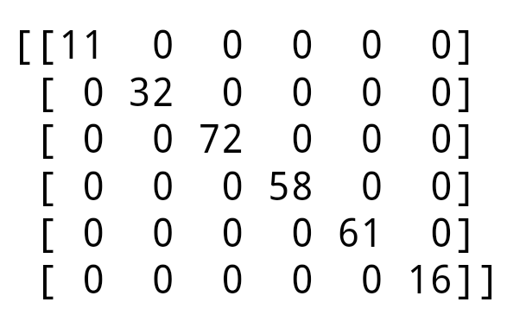
#Decision Forest
from sklearn.tree import DecisionTreeClassifier
# creating a model
model = DecisionTreeClassifier()
# feeding the training data to the model
model.fit(x_train, y_train)
# predicting the x-test results
y_pred = model.predict(x_test)
# calculating the accuracies
print("Training Accuracy :", model.score(x_train, y_train))
print("Testing Accuracy :", model.score(x_test, y_test))
Output:
Training Accuracy : 1.0
Testing Accuracy : 1.0
# printing the confusion matrix
from sklearn.metrics import confusion_matrix
# creating a confusion matrix
cm = confusion_matrix(y_test, y_pred)
# printing the confusion matrix
print(cm)

Slide 48
# k fold cross validation
from sklearn.model_selection import cross_val_score
# computing accuracies for 20 different model's accuracy
accuracies = cross_val_score(estimator = model, X = x_train, y = y_train, cv = 20)
print(accuracies)
# computing mean of accuaracies obtained by all the models
print("mean accuracy :", accuracies.mean())
# computing the standard variance of the models
print("mean standard variance :", accuracies.std())
Output:
[1. 1. 1. 1. 1. 1. 1. 1. 1. 1. 1. 1. 1. 1. 1. 1. 1. 1. 1. 1.]
mean accuracy : 1.0
mean standard variance : 0.0

Slide 49
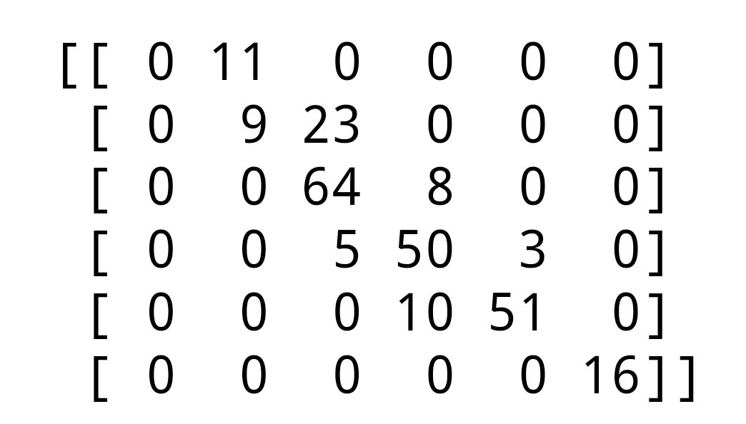
#Support Vector Machine
fom sklearn.svm import SVC
# creating a model
model = SVC()
# feeding the training data to the model
model.fit(x_train, y_train)
# predicting the x-test results
y_pred = model.predict(x_test)
# calculating the accuracies
print("Training Accuracy :", model.score(x_train, y_train))
print("Testing Accuracy :", model.score(x_test, y_test))
Output:
Training Accuracy : 0.732
Testing Accuracy : 0.76
# printing the confusion matrix
#fom sklearn.metrics import confusion_matrix
#creating a confusion matrix
cm = confusion_matrix(y_test, y_pred)
# printing the confusion matrix
print(cm)

Slide 50
Future scope
Various methods have been proposed by previous researchers to develop the best performance model using variety of students data, techniques, algorithms and tools. Predictive modeling used in predicting student performance are related to several learning tasks such as classification, regression and clustering. To achieve best prediction model, a lot of variables have been chosen and tested to find most influential attributes to perform prediction.
Accurate performance prediction will be helpful in order to provide guidance in learning process that will benefit to students in avoiding poor scores. The predictive model furthermore can help instructor to forecast course completion including student final grade which are directly correlated to student performance success. To harvest an effective predictive model, it requires a good input data and variables, suitable predictive method as well as powerful and robust prediction model.

Slide 51
After we have verified the model proposed, the most imminent future work is to analyze and design a big data architecture that supports the processing of the large amount of academic data that the university generates periodically.
This academic data should be also complemented with other data, such as personal and socio-economic information of the student and information on the student learning assessment system, among others. This large volume of data can be increased by scaling up the proposal of this paper for all the university’s degrees.To define the project architecture, it is not recommended to use a traditional approach based on a data warehouse; rather, due to the nature of the proposed project, it will be necessary to create a documented, scalable, and flexible database that can support large indexing and data consultation by students, teachers, and educational administrators.

Slide 52
Conclusion
Predicting student performance is most effective way to improve educators and leaners improving their learning process as well as student graduating within normal program duration. Previous studies have used various methods to build best predictive model. To achieve the best model, a lot of variables have been chosen and tested to find most influential attributes to perform prediction.
Most of the researchers have used CGPA, attendance, gender and assessment mark. There are a few of the attributes which give most significant impact whether the student will be survived to finish their study or not. The prediction methods is one of the critical components for analyzing student performance. Most of the researchers are using classification, regression and clustering methods such as BN, DT, ANN, SVM, KNN and others.

Slide 53
References
S. K. Yadav, B. Bharadwaj, and S. Pal, “Data mining applications: A comparative study for predicting student's performance,” International Journal of Innovative Technology and Creative Engineering, vol. 1, no. 12, pp. 13- 19, 2011.
C. Romero and S. Ventura, “Educational data mining: A survey from 1995 to 2005,” Expert systems with applications, vol. 33, no. 1, pp. 135-146, 2007.
E. Lotsari, V. Verykios, C. Panagiotakopoulos, and D. Kalles, “A Learning Analytics Methodology for Student Profiling,” in Artificial Intelligence: Methods and Applications, 2014, pp. 300-312.
P. J. Piety, D. T. Hickey, and M. J. Bishop, “Educational data sciences: Framing emergent practices for analytics of learning, organizations, and systems,” in 4th International Conference on Learning Analytics and Knowledge, 2014, p. 193.
G., Siemens and P Long, “Penetrating the fog: Analytics in learning and education,” EDUCAUSE Review, vol. 46, no. 5, 2011.
S. K. Yadav, B. Bharadwaj, and S. Pal, “Data mining applications: A comparative study for predicting student's performance,” International Journal of Innovative Technology and Creative Engineering, vol. 1, no. 12, pp.
And many others.

Slide 54
Any queries?

Slide 55
Thank you.

